Slide 1
MNCVSM
Nydrel Jack
Arianne Perez
Chelsi Taylor
Ethan Vargas
Nathanael Williams
Advisor: Dr. Ying Zhang
Georgia Institute of Technology
School of Electrical and Computer Engineering
January 15, 2019
Notes:
1 - 6: Arianne
7 - 9: Nydrel
10 - 14: Chelsi
15 - 19: Nathanael
20 - 22: Ethan

Slide 2
What is MNCVSM?

Slide 3
Mobile
Non-
Contact
Vital
Sign
Monitoring
MNCVSM

Slide 4
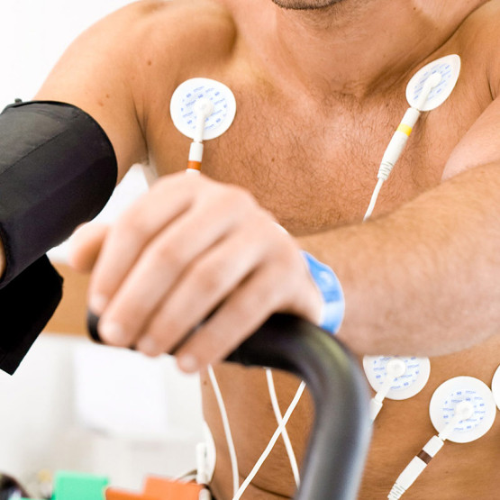
Motivation
Over 450,000 deaths could be prevented with continuous health monitoring
Current health monitoring systems may:
Require medical professionals for accurate measurements
Require physical contact with the user that confines the user to one area
Require active effort from the user
Provide non-continuous monitoring
Image source: www.moduldiagram.com/ecg-accessories/

Slide 5
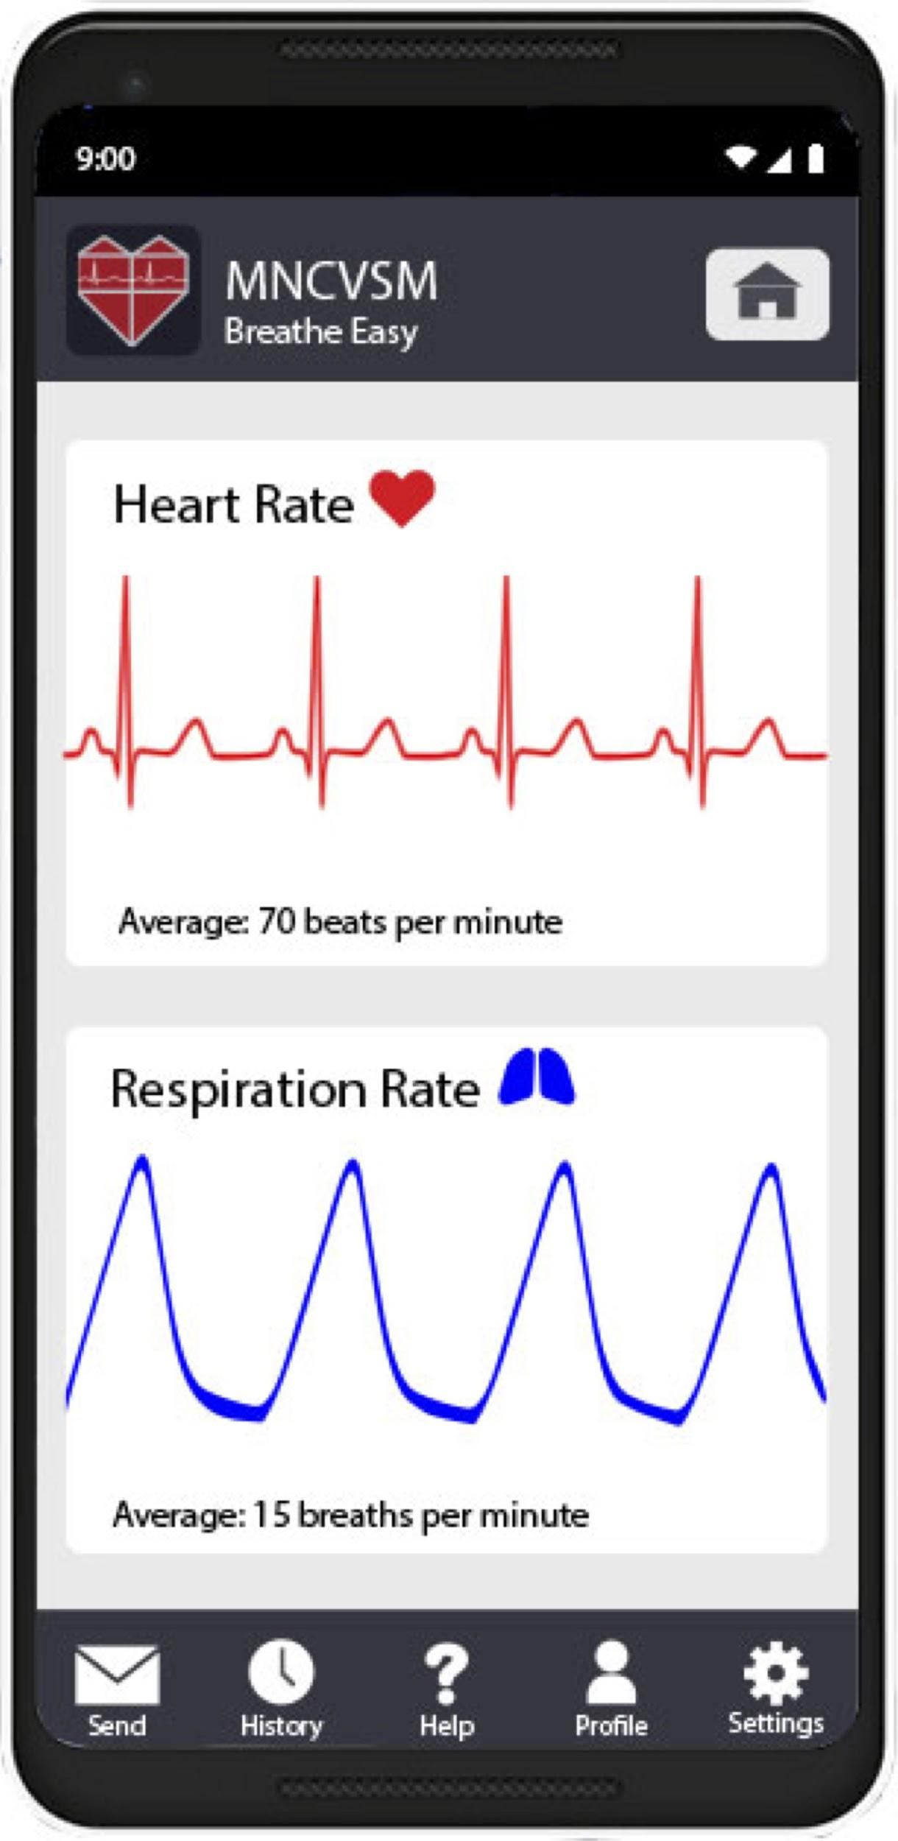
Objectives
Continuously process and transmit vital sign data (heart and respiratory rate) to a mobile device in real-time
Display vital sign data in a user-friendly mobile application designed for both medically and non-medically trained individuals
Minimize amount of integrated technology
Notes:
Increase likelihood of detecting health problems
Audience: Probably just Dr. Zhang and her Grad Student(s)
From our proposal: “The purpose of this project is to design and build a prototype for a system that receives, processes, and transmits vital sign data to a mobile application to be displayed in real-time”
Develop a user friendly mobile application to display vital sign data
Cardiac events
Respiratory events

Slide 6
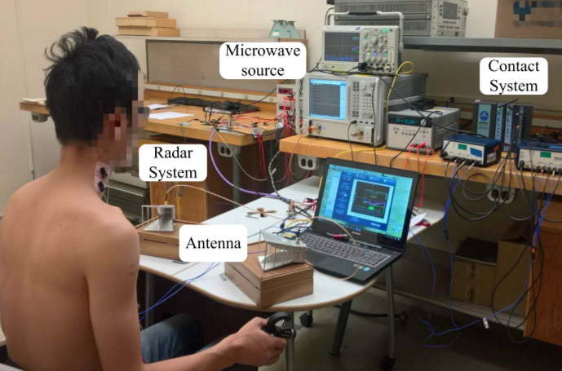
Non-Contact Vital Sign Acquisition
Receives signal using Doppler radar-based technology
Builds off of Dr. Zhang’s research
No contact with the patient
Continuously monitors heart and respiratory rate
Approved for testing by IRB
Image source: Dr. Zhang’s 2018 Journal Article
Notes:
Audience: Dr. Zhang, maybe her Grad Student(s), maybe other students
We will call the person who’s vital sign is being measured “the patient”
“non-contact vital sign acquisition system”
***maybe: → NAHOM: explain how our project is different
Dr. Zhang and her graduate students have received IRB approval for testing

Slide 7
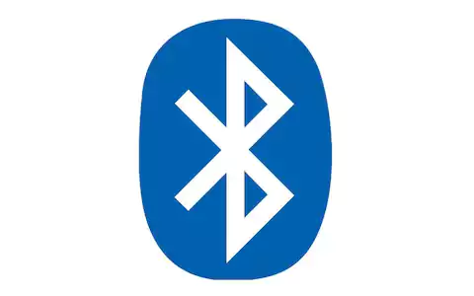
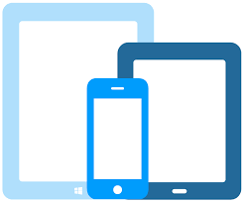
Project Needs
Analog-to-Digital converter
Microcontroller
UART connection
Bluetooth module
Mobile device
Bluetooth image source: www.telegraph.co.uk/technology/
Devices image: www.broswerstack.com/live
Notes:
https://www.telegraph.co.uk/technology/0/bluetooth-5-need-know-new-wireless-technology/
https://www.browserstack.com/live

Slide 8
Technical Specifications
Microcontroller Unit Specifications
ADC Specifications
Feature | Specification
SPI Data Rate | ≥ 24 kB/s
Data Processing Ability | dedicated floating-point unit
Power Supply | < 5.0 V
Size | no specific size; should be considered portable
Feature | Specification
Bit Resolution | ≥ 16 bits
Number of Channels | 3 channels
Sampling Rate | ≥ 1000 samples/channel/second

Slide 9
Technical Specifications
Bluetooth Module Specifications
Mobile Application and Device Specifications
Feature | Specification
Data Throughput | ≥ 1 Mbps
Inter-device Range | ≥ 20 meters
Bandwidth | 2.4 GHz
Power Supply | < 5.0 V
Peak Power Consumption | ≤ 80 mW
Size | should be no larger than a standard evaluation board
Feature | Specification
Operating System | Android 5.0 or greater
Wireless Communication | Bluetooth capable
Display and Plotting Ability | real-time plotting of analyzed data

Slide 10
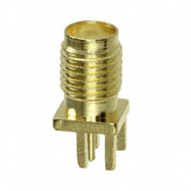
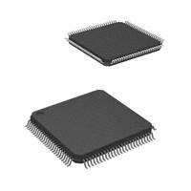
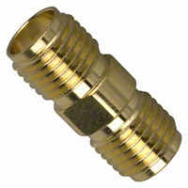
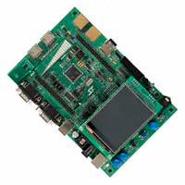
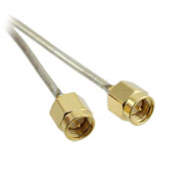
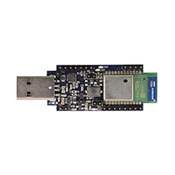
Component Selection
STM32F373VCT6 Microcontroller
STM32F373VCT6 Microcontroller Evaluation Board
SPBT3.0DP1 Bluetooth Classic Module
SPBT3.0DP1 Bluetooth Classic Module Evaluation Board
CON-SMA-EDGE-S Jack Connector
CCSMA-MM-086-8 Coaxial Cable
132169 Coaxial Connector
Images source: www.digikey.com
Notes:
Talk about why we selected these components

Slide 11
Prototype Cost
Equipment Costs for Prototype
Product Description | Quantity | Unit Price | Cost
STM32F373VCT6 Microcontroller | 1 | $5.81 | $5.81
STM32F373VCT6 Evaluation Board | 1 | $248.75 | $248.75
SPBT3.0DP1 Bluetooth Classic Module | 1 | $14.10 | $14.10
SPBT3.0DP1 Bluetooth Classic Module Evaluation Board | 1 | $47.25 | $47.25
CON-SMA-EDGE-S Jack Connector | 4 | $1.74 | $6.96
CCSMA-MM-086-8 Coaxial Cable | 4 | $10.68 | $42.72
132169 Coaxial Connector | 4 | $5.76 | $23.04
Total |  |  | $388.63

Slide 12
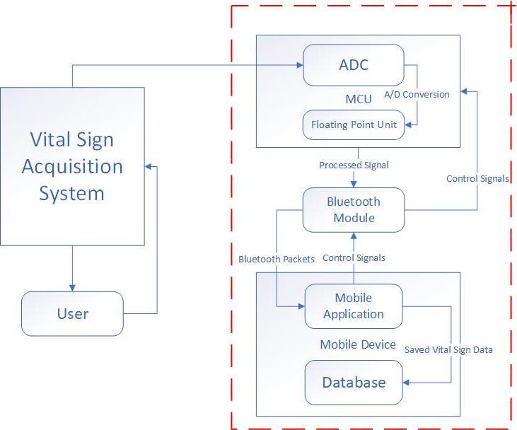
Design Approach
Signal processing
Wireless communication
Mobile application development
User interface implementation
Notes:
REDO diagram - fewer blocks? reshape? numbered boxes? dashed boxes?

Slide 13
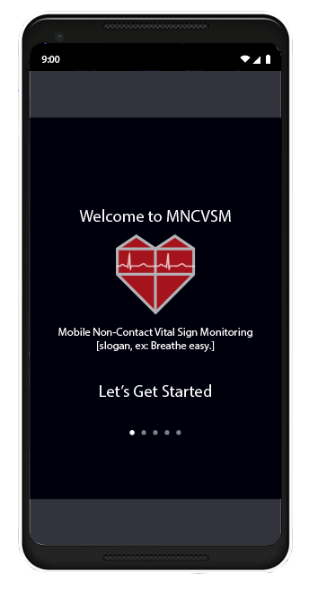
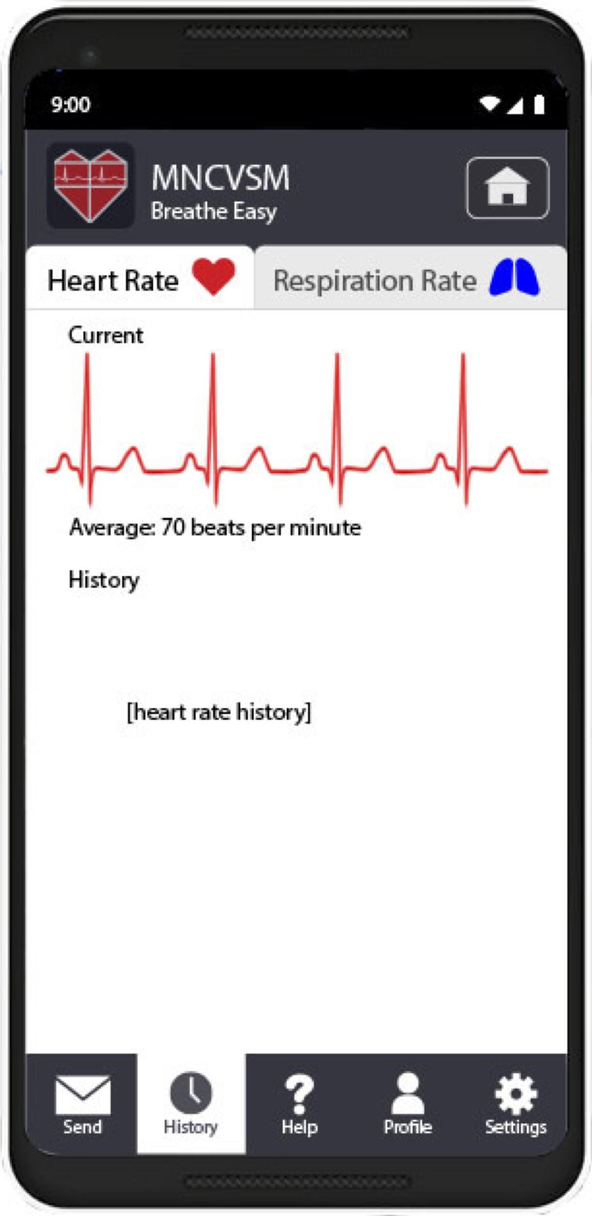
Final Demonstration
Navigation of mobile application
Real-time display of vital signs
Graphs of vital sign history
Notes:
New idea**
Simultaneously have an EKG reading and a MNCVSM reading with a live user, or have
Hook up a volunteer (or one of us) to an EKG, if there is one available to us
Initiate vital sign monitoring
Display heart rate and respiration rate
Save vital sign information in local database
Review data from previous sessions

Slide 14
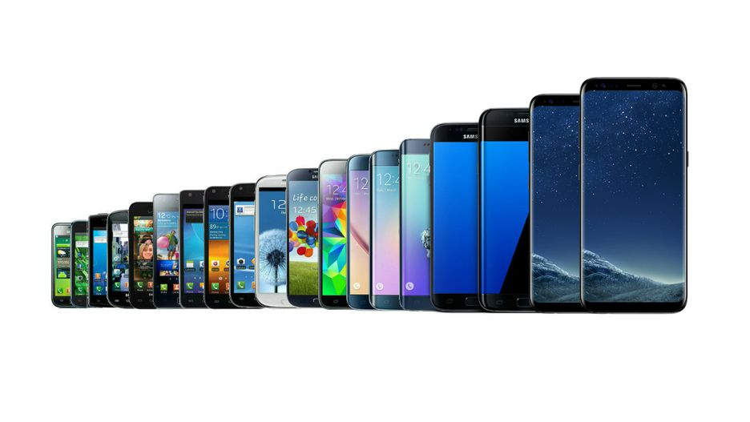
Current Status
Product Selection
Microcontroller (STMicroelectronics STM32F373VCT6 Microcontroller)
Bluetooth module (STMicroelectronics SPBT3.0DP1 Bluetooth Classic)
Android version (Android version 5.0)
Screen layouts for user interface
Researched
Digital Signal Processing Methods
Wireless Communication Protocols
Remaining Decisions
Image source: www.cnet.com/pictures/
Notes:
Remaining decisions - processing capability research

Slide 15
Proposed Schedule
Notes:
Explain why it’s there and how it’s done

Slide 16
Module Schedule
Notes:
Three-phase approach: Phase I (last semester), Phase II (implementation), Phase III (final deliverables)
Modular approach - subteams for each aspect of the project
This includes a month of testing the system
Finish before Spring Break - leaves time for Phase III

Slide 17
Preliminary Tasks
Notes:
Initial tasks necessary for getting approval and starting work on the project

Slide 18
Data Acquisition and Signal Processing
Notes:
Develop signal processing method to acquire vital sign information from signal
Implement this algorithm within the microcontroller
Test this algorithm

Slide 19
Wireless Communication
Notes:
Connect the microcontroller to the mobile device
Ensure accurate data transfer

Slide 20
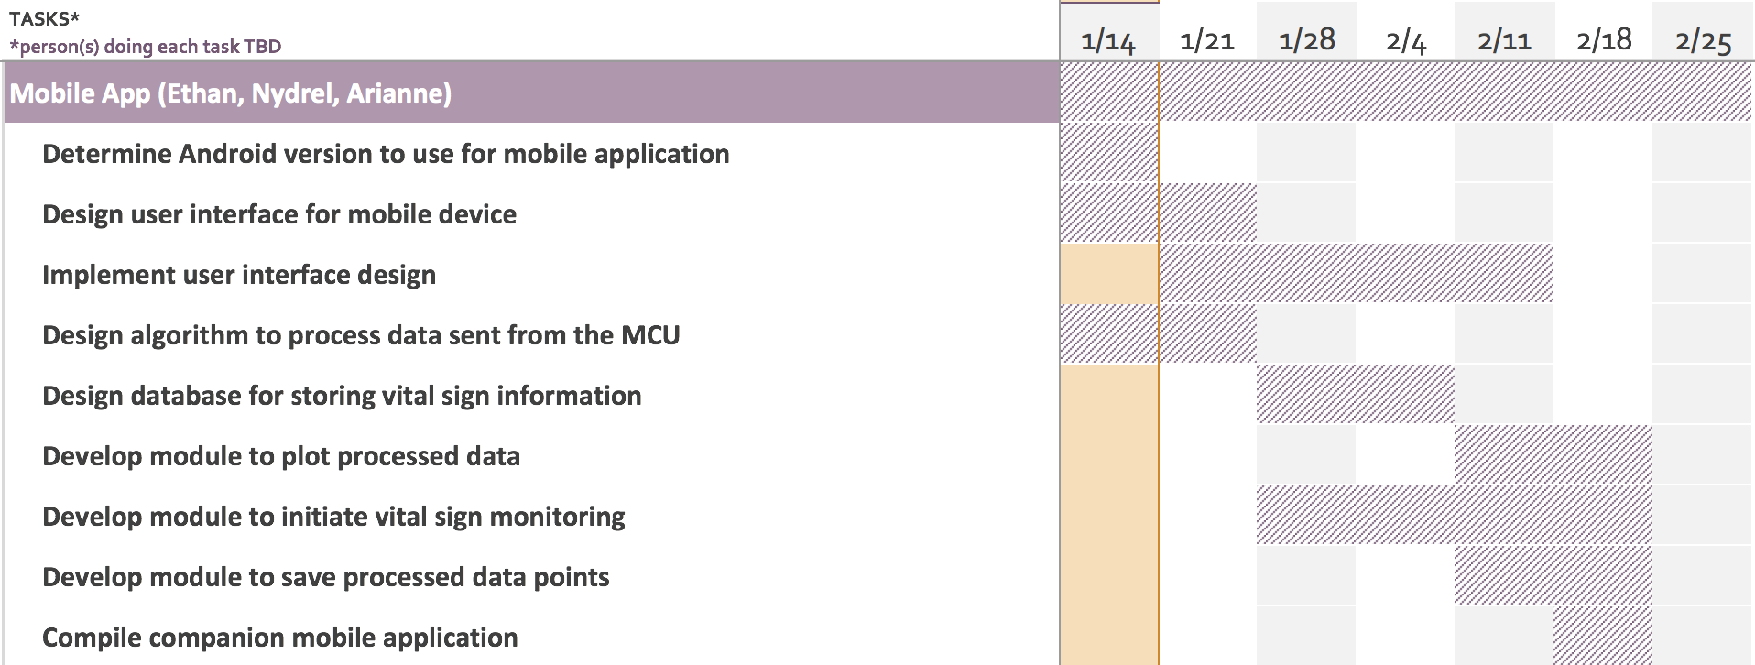
Mobile Application

Slide 21
Testing

Slide 22
Final Deliverables

Slide 23
Thank you

